Slide 1
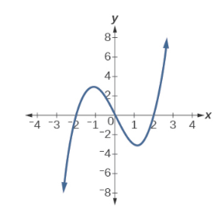
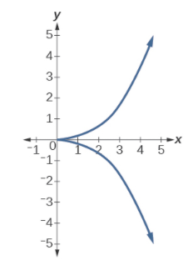
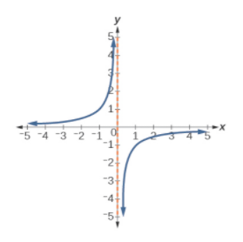
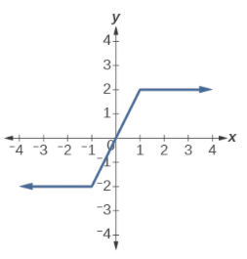
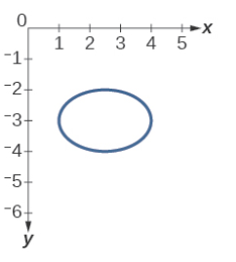

Exercises
Which graphs show relations that are functions

Slide 2
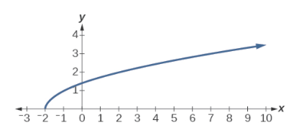
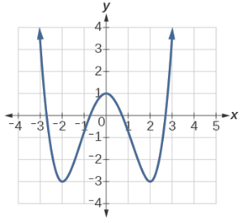
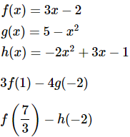
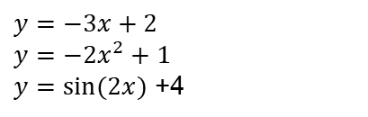

Exercises
Given the following graph,
Evaluate f(−1). #1
Solve for f(x)=3. #7
Given the following graph,
Evaluate f(0). #1
Solve for f(x)=−3. #-2 e 2
Evaluate the expressions, given functions f, g, and h:
1. #-1
2. #20
Plot the following functions on Python:
$y=x^{4}$ +3
$y=x^{5}$+4x
$y=\sqrt{x}$ +6
$$y=\sqrt[3]{x}$$
$$y=\tan{x}$$
$$y=−x+2$$
$$y=−3x+2$$
$$y=−{2x}^{2}+1$$
$y=\sin{(2x})$ +4

Slide 3
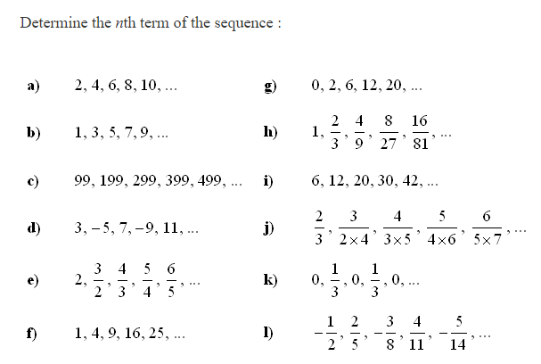
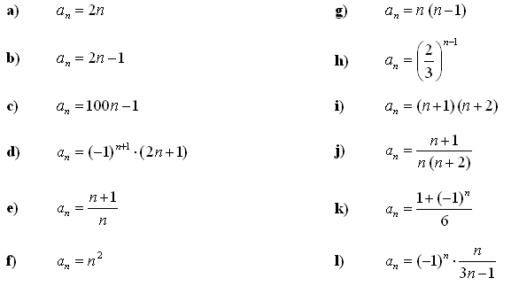
Exercises

Slide 4
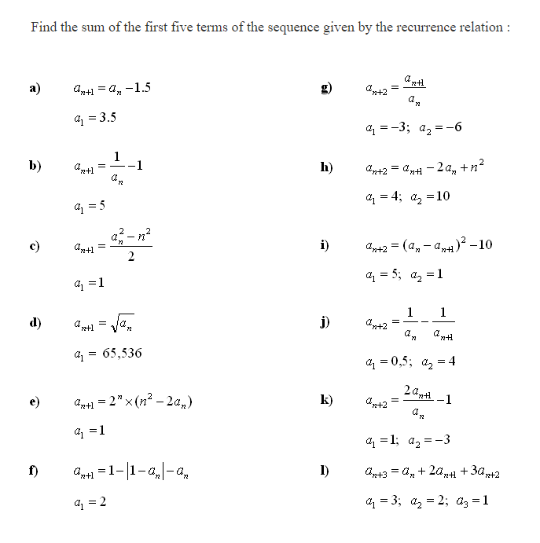
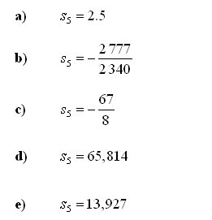
Exercises
solution

